Slide 1
Registers
CF

Slide 2
Computer Register
Registers are a type of computer memory used to quickly accept, store, and transfer data and instructions that are being used immediately by the CPU. The registers used by the CPU are often termed as Processor registers.
A processor register may hold an instruction, a storage address, or any data (such as bit sequence or individual characters).
The computer needs processor registers for manipulating data and a register for holding a memory address. The register holding the memory location is used to calculate the address of the next instruction after the execution of the current instruction is completed.

Slide 3
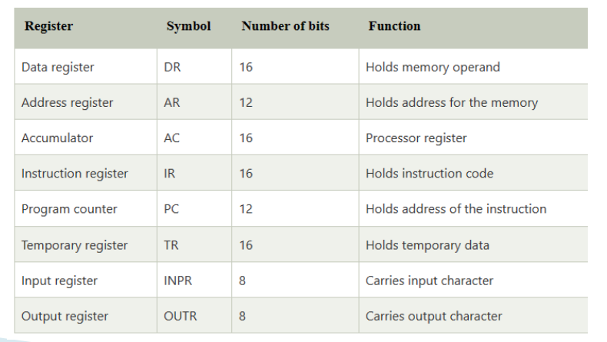

Slide 4
Instruction Register
The instruction register (IR) is used to hold the instruction that is currently being executed. The contents of IR are available to the control unit, which generate the timing signals that control the various processing elements involved in executing the instruction.

Slide 5
Program Counter
The Program Counter is one of the most important registers in the CPU. A program is a series of instructions stored in the memory. These instructions tell the CPU exactly how to get the desired result. It is important that these instructions must be executed in a proper order to get the correct result. This sequence of instruction execution is monitored by the program counter. It keeps track of which instruction is being executed and what the next instruction will be.

Slide 6
Stack pointer
Stack pointer (SP) is used to point to the top activation record on the run-time stack. The run-time stack contains one activation record for each function or procedure invocation that is currently unfinished in the program. The top activation record corresponds to the current function invocation. When a function call is made an activation record is pushed onto the run-time stack. When a function returns, the activation record is popped by decrementing the stack pointer to point to the previous activation record.

Slide 7
ACC:
Accumulator is one of the general purpose registers but it is specifically used to 'accumulate' the result of the currently running instructions.

Slide 8
MAR
MAR are used to handle the data transfer between the main memory and the processor. The MAR holds the address of the main memory to or from which data is to be transferred.

Slide 9
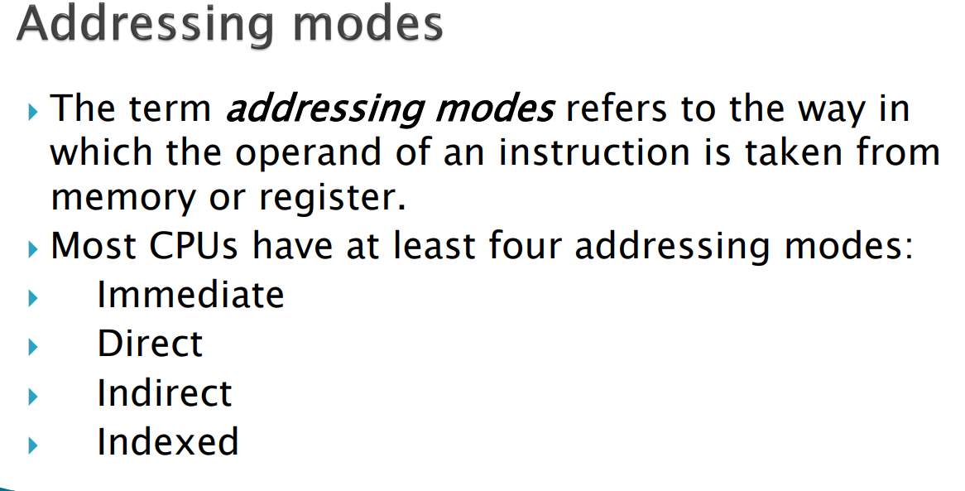

Slide 10
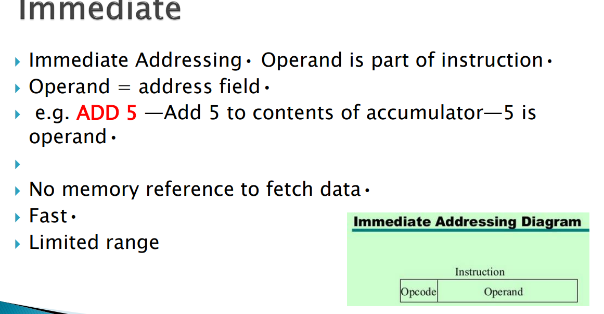

Slide 11
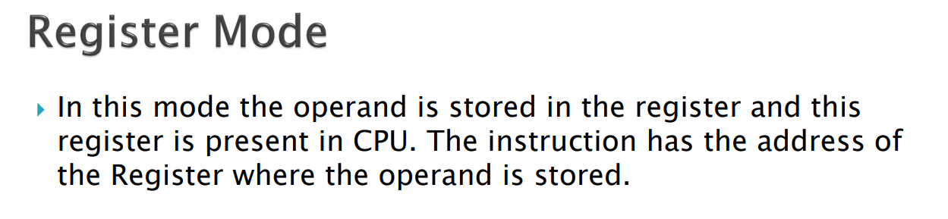
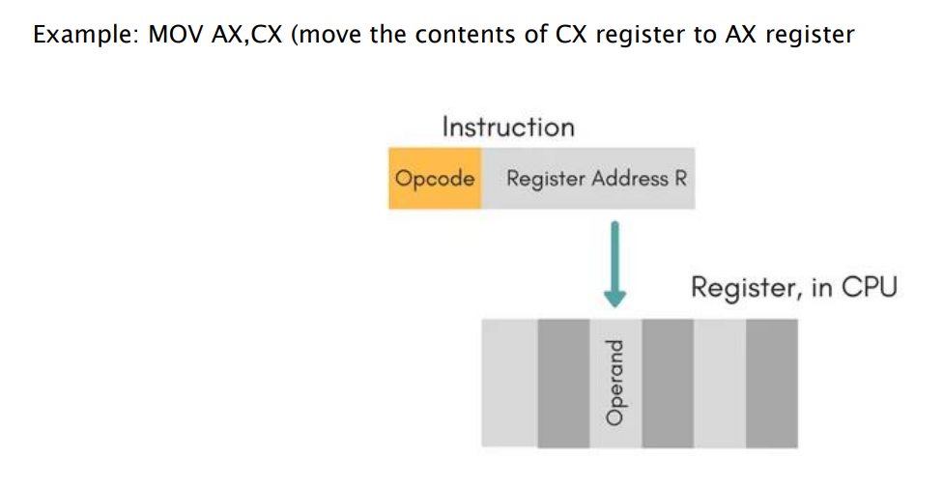

Slide 12
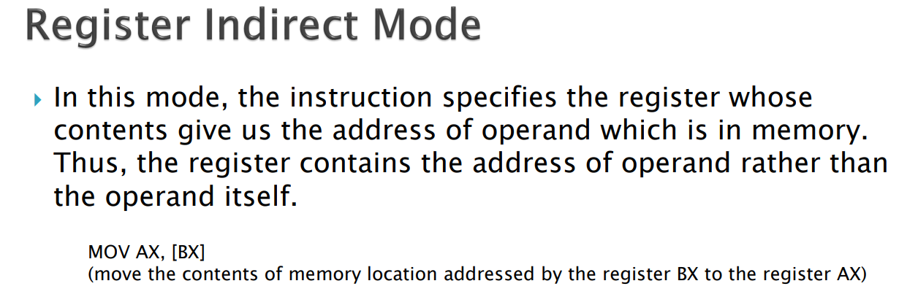
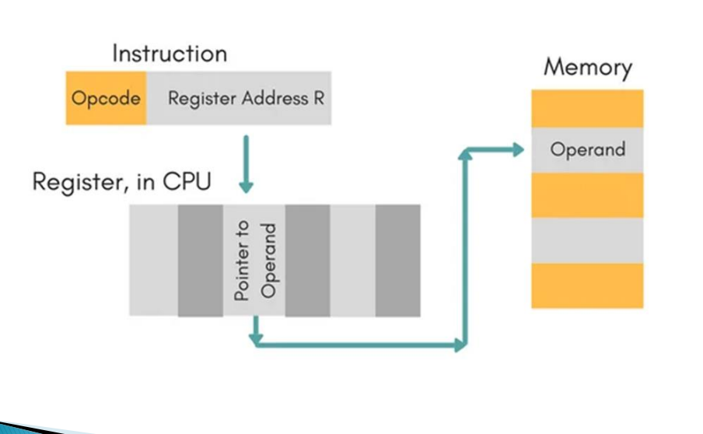

Slide 13
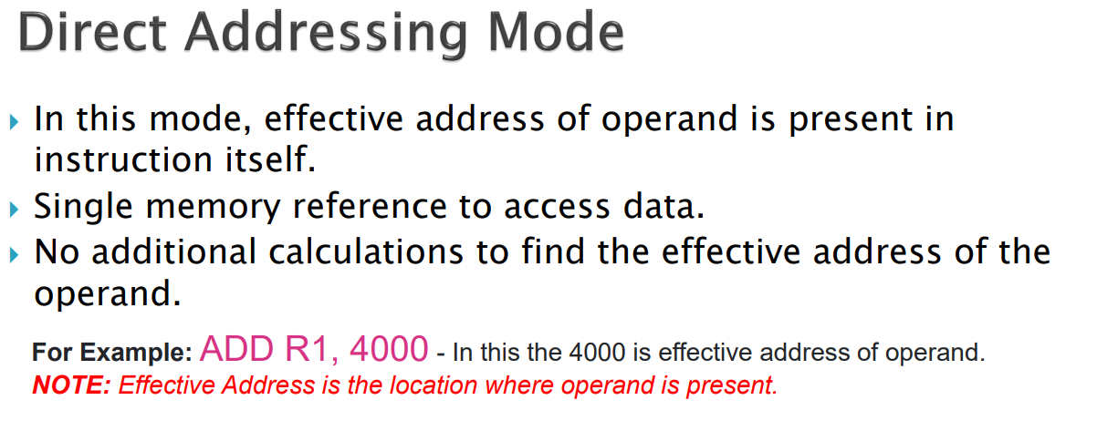
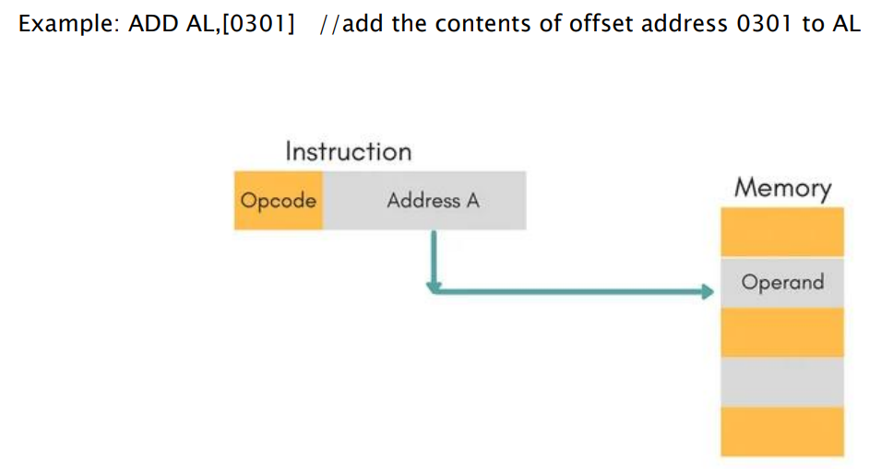

Slide 14
